Slide 1



Robust yield prediction of various farm processing units
Reesu Jagan
Batch-111

Slide 2
Agenda
Introduction
Exploratory data analysis
Preprocess
Model Building
Summary

Slide 3

Introduction
Accurate yield forecasts help farmers, agricultural companies, and governments to plan for the upcoming season.
By knowing how much yield to expect, they can make informed decisions about the amount of seed, fertilizer, and other inputs needed, as well as the amount of storage and transportation capacity required.
3

Slide 4
Problem Statement
A new fast-food chain is seeing rapid expansion over the past couple of years.
They are now trying to optimize their supply chain to ensure that there are no shortages of ingredients. For this, they’ve tasked the data science team to come up with a model that could predict the output of each food processing farm over the next few years.
These predictions could further increase the efficiency of their current supply chain management systems.

Slide 5
Objectives
Explore the data and engineer new features.
Predict the yield for each farm during the given timestamps.
Given the forecasted demand for the next few months for a particular ingredient, device a strategy to source it, creating a strategy to source ‘ing_w’ ingredient type.

Slide 6
Timeline
7 Days
2 days
Data Cleaning
Communicate the results
Data Understanding
5 days
4 days
3 days
Explotary Data Analysis
Build and validate models& methodologies
6

Slide 7
Data Handling
The Data Size is Huge it consumes whole ram (8gb) so handling ,this kind of data needed special approaches.
Feather format- fast read and write performance, and support for a wide range of data types.
They are designed to be memory-mapped, which means that they can be accessed without the need for loading the entire file into memory.
Downcasting refers to the process of converting a numerical data type to a smaller data type that can still accurately represent the original data. This can be useful in situations where memory usage is a concern, as smaller data types require less memory.

Slide 8

Exploratory Data Analysis
The Datasets: There are 5 different datasets (train_data,farm,weather,test_test_weather)
To explore data and new features need to merge the data
Merged Train data contains 16(yield) columns and 2,06,00,899 rows
Merged test data contains 16 columns (id) columns and 2,15,00,309

Slide 9
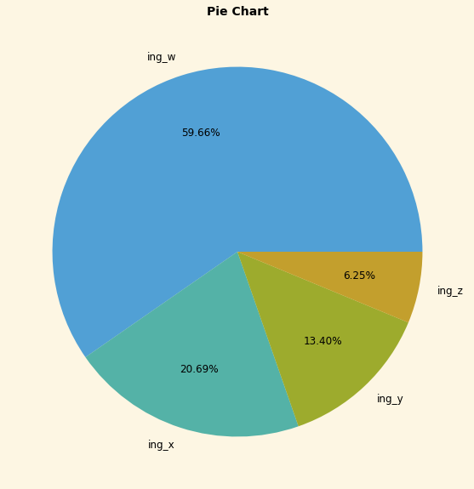
Ingredient-Y
Ingredient-x
Ingredient-w
Data
Ingredient-Z
1398 farms
496 farms
324 farms
145 farms
12280,032
4356864
2846016
1273680
20756592

Slide 10
Data Description:
Train_data: Consists of Crop Information, The dataset is mainly around different types of ingredients
date: The timestamp at which the yield of the food processing farm was measured
farm_id: The farm identifier that recognizes the farm food processing plant
ingredient_type: The type of ingredient being produced
yield: The yield of the plant in tonnes
farm_data: Consists of the Farm Data and Field Management Information
farm_id: The farm identifier that recognizes the farm food processing plant.
operations_commencing_year: The founding year when the operations commenced on the farm and food processing plant.
num_processing_plants: The number of processing plants present on the farm.
farm_area: The area of the farm in square meters.
farming_company: The company that owns the farms.
deidentified_location: The location at which the farm is present.
Weather Data: Weather related information data

Slide 11
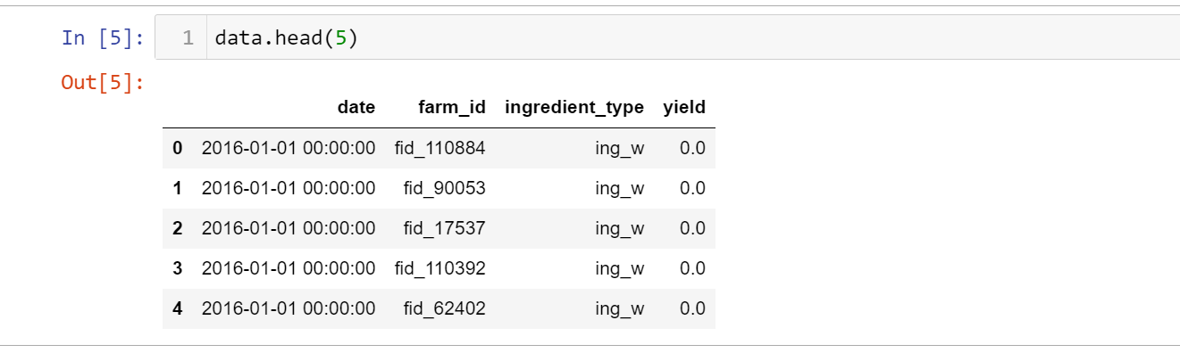
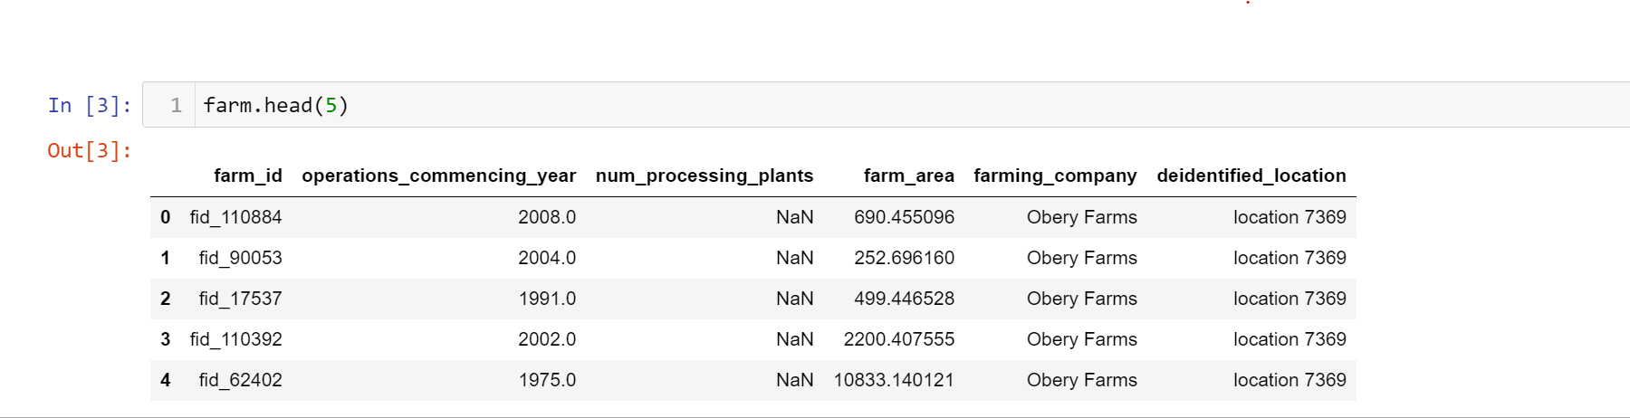
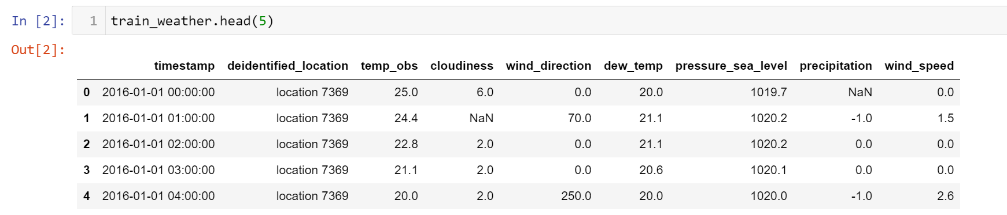
Data

Slide 12
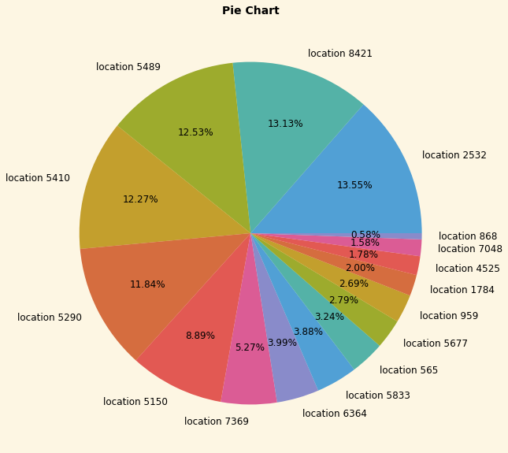
There are 16 different companies produced different ingredients
In 2016 ,91% of yield produced by 6 companies and rest produced 9% of yield
Some companies produced all ingredients and some are produced certain only
There are 16 different locations in given dataset

Slide 13

Question Based Exploratory Data Analysis

Slide 14
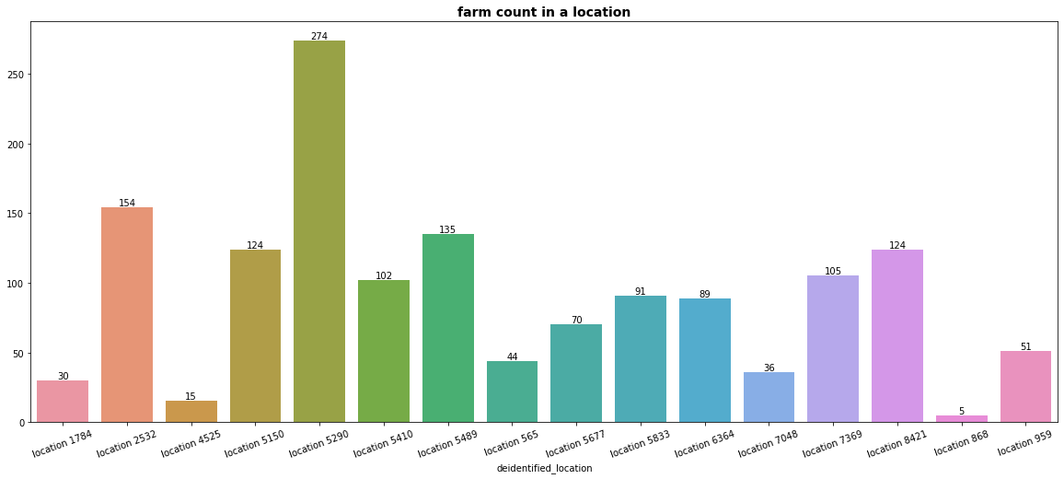
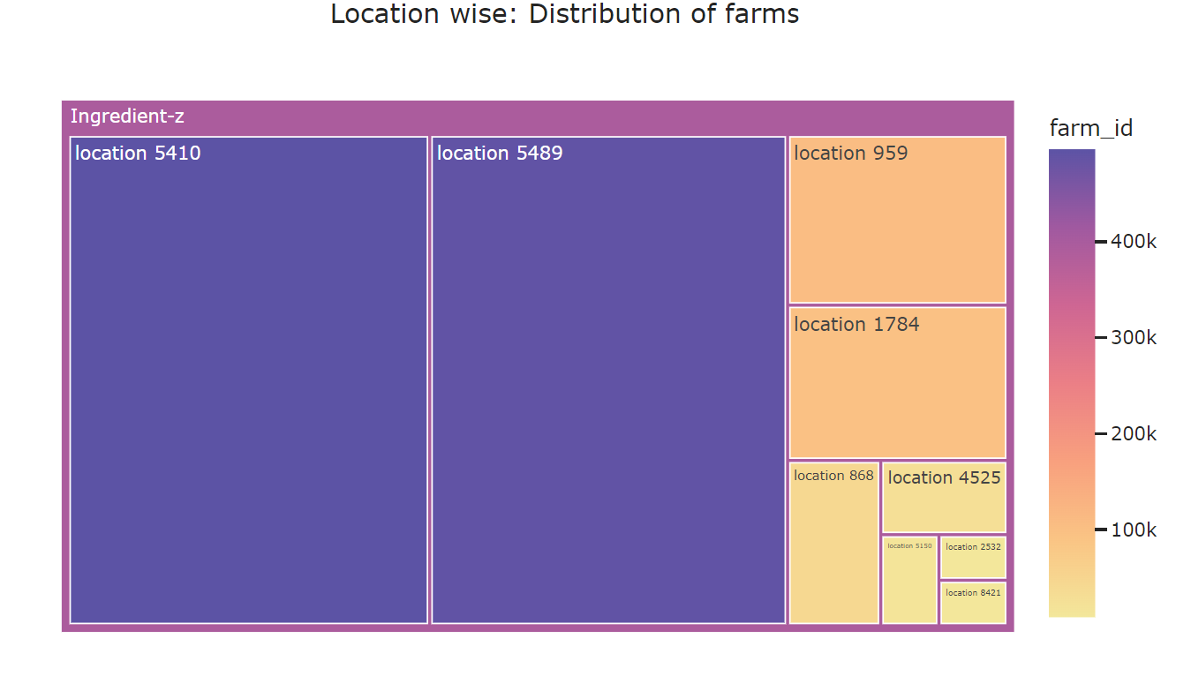
Are farms distributed uniformaly?
Farms are not uniformaly distributed and they are random

Slide 15
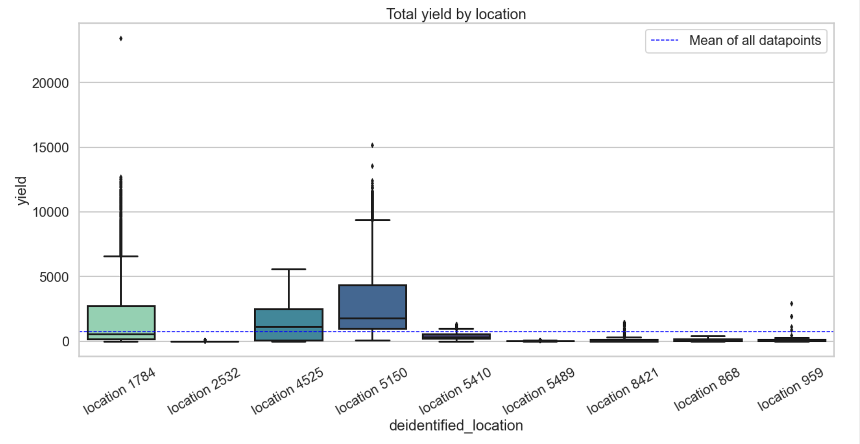
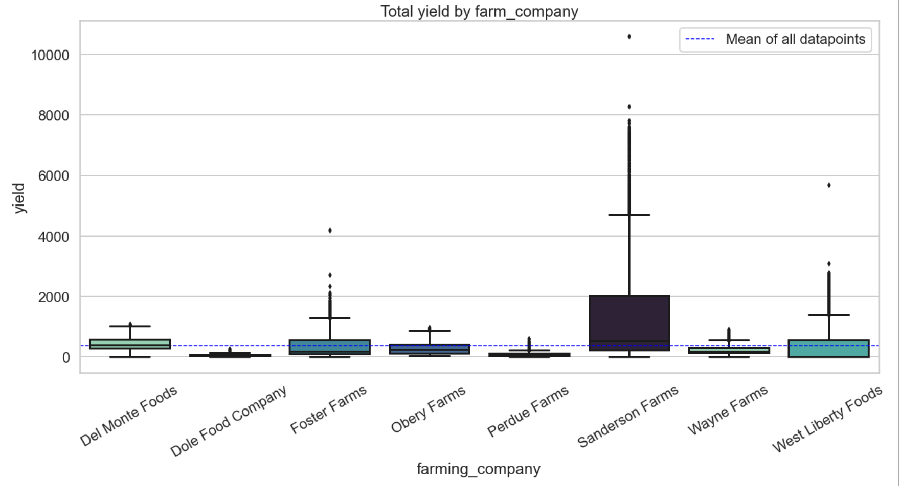
How do yield differ from different companies & locations?
They are six different locations which below the total average yield
Location 1784,4525,5150 produced more yield
Sanderson farms produced more yield in ingredient-z
There are 4 different companies produced below total average yield

Slide 16
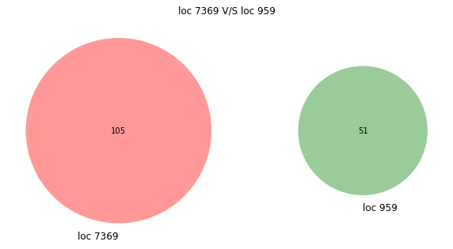
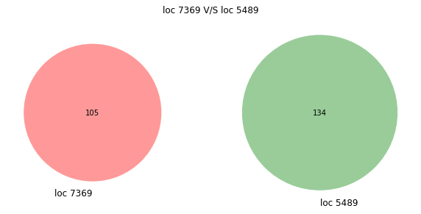
Are farms overlapping in different locations?
Taking 3 different locations randomly and check their unique farms
Performed set operations and results disjoint sets
But in case of farming_company there are
15 farms which shared by two companies with different locations

Slide 17
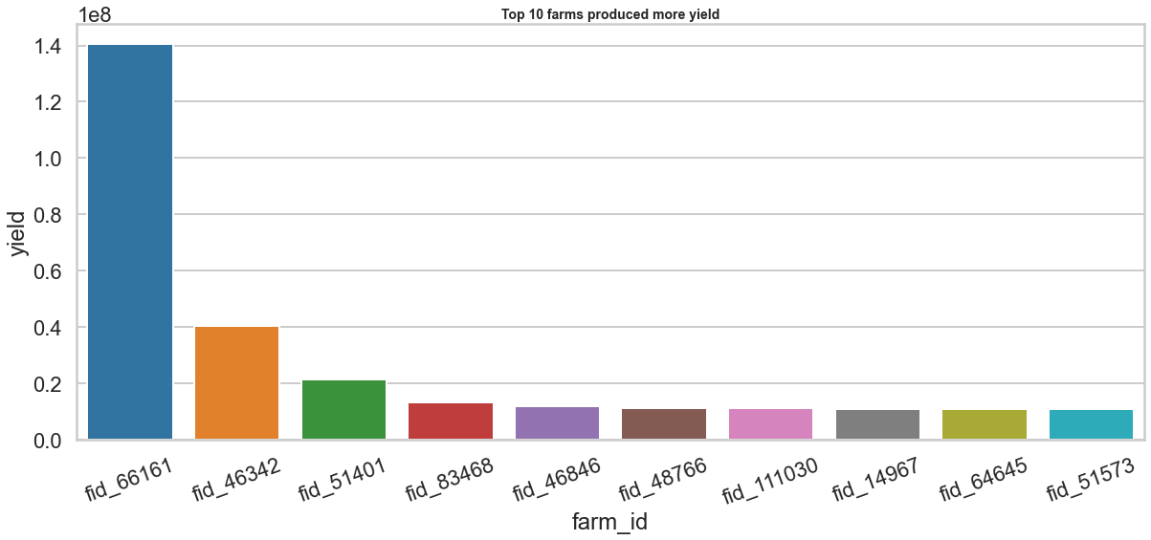
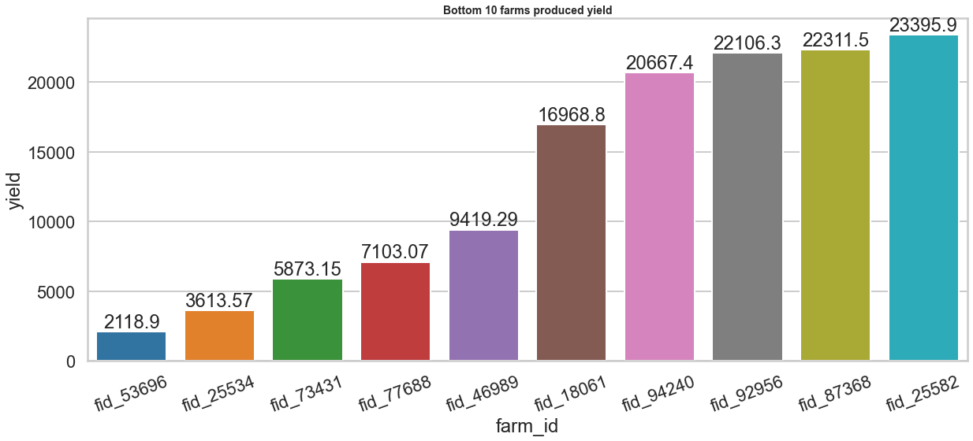
What are the Top & Bottom 10 farms produced more yield?

Slide 18
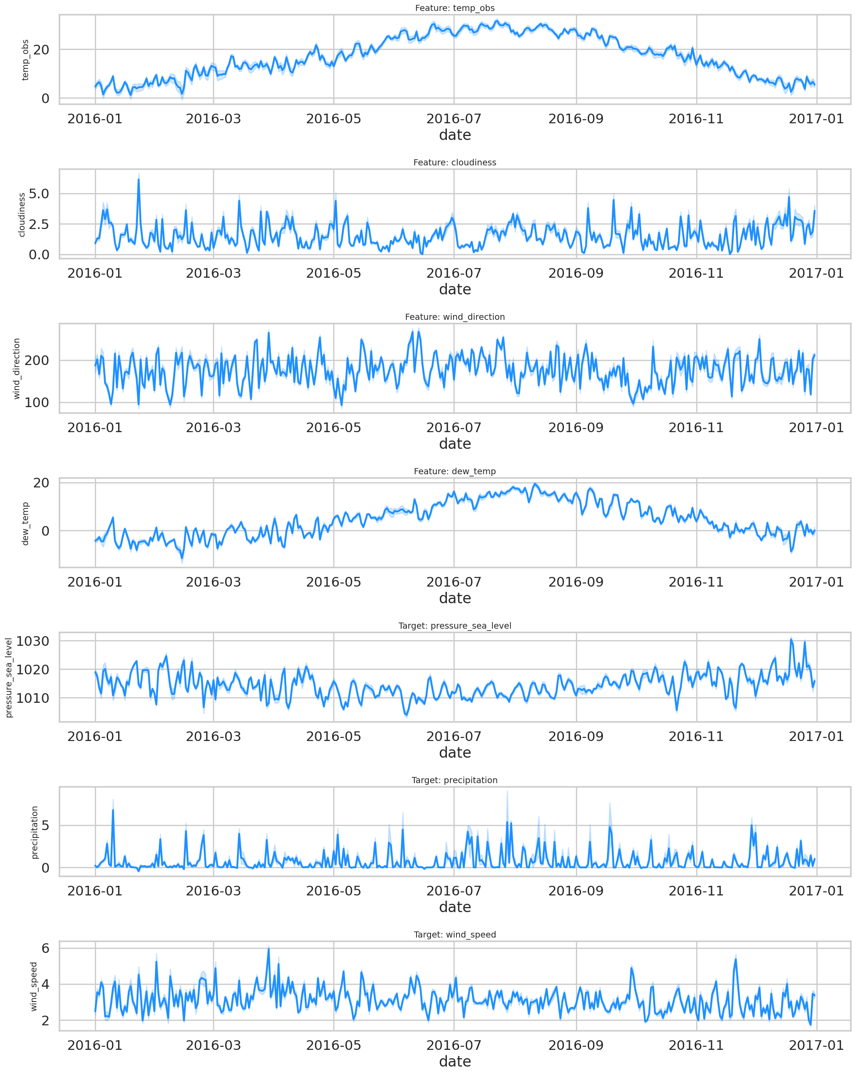
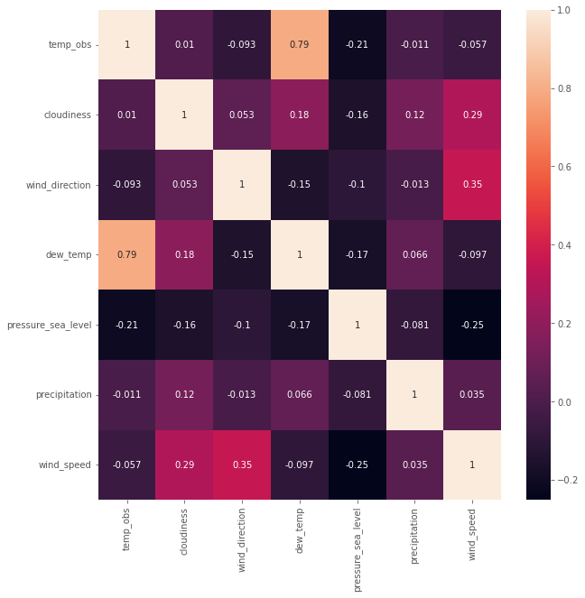
Any Trend,seasonality with weather data?
In temperature upto July (summer)there is uptrend and then downtrend
Seasonality across wind direction ,precipitation, wind speed
Correlation between dew and temp

Slide 19
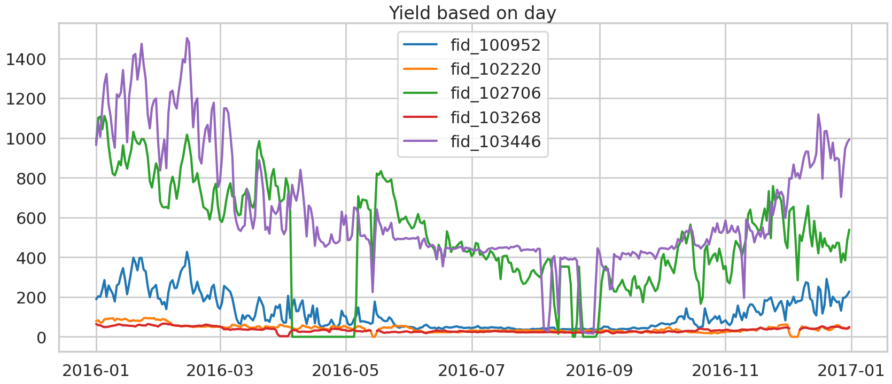
How Yield differs based on farm_id?

Slide 20
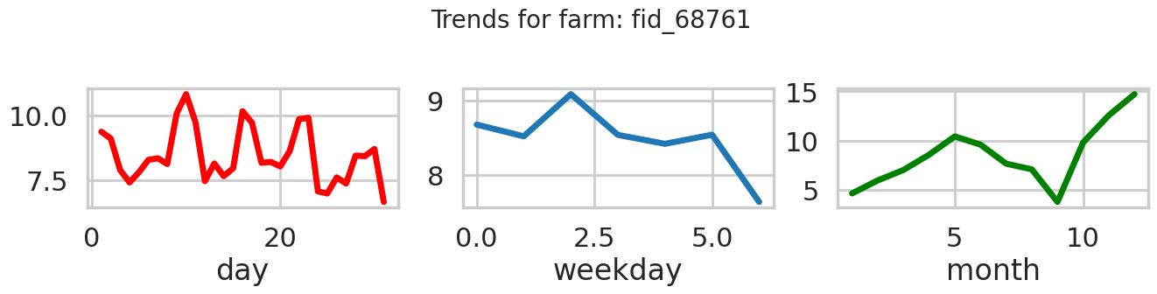
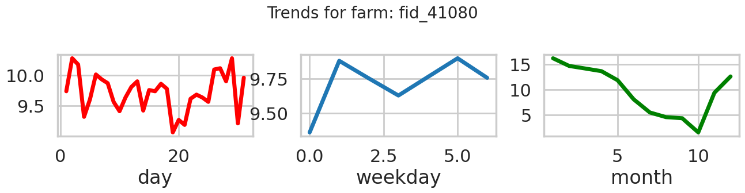
Any trend or relation if Yield broken down by time variables?
Observation: Down trend from 5-10 months but on day,weekly are completely random

Slide 21
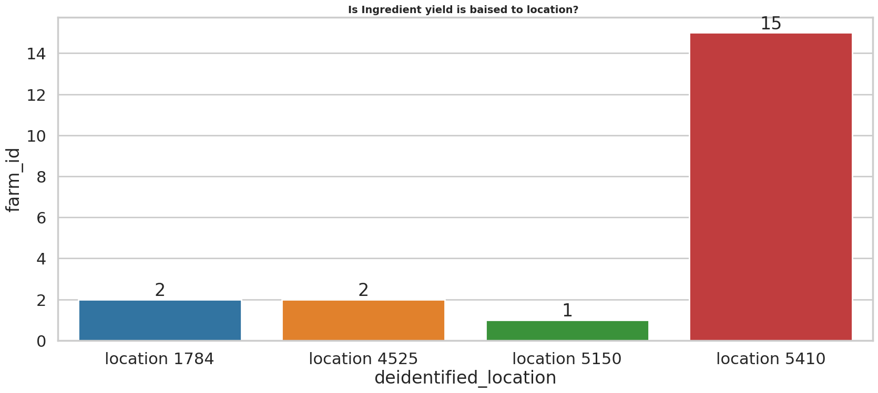
Is Yield is biased to location?
Took top 20 farms which produced more yield and check the farm-location count
Out of 15/20 Location 5410 have more records
It clearly states that at certain location yield is more

Slide 22
Data preprocessing
“ Data preprocessing is a process of preparing the raw data and making it suitable for a machine learning model ”

Slide 23
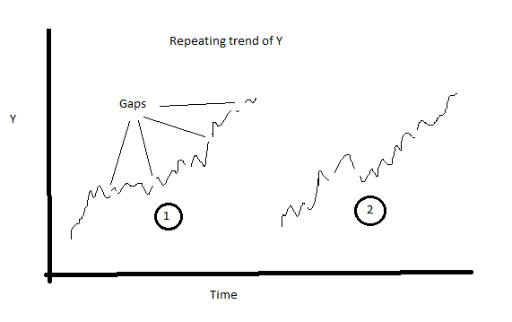
Do we have missing timestamps?
Yes, There are missing time stamps which cause discontunity
Before padding the time series we must ensure there are no duplicates in the sense at same time stamp at same farm_id should not have more than one record .so ,There are time stamp may have similar records need to aggregate on attribute wise
Then re indext the data with padding series
Except Date column we have null values to impute

Slide 24
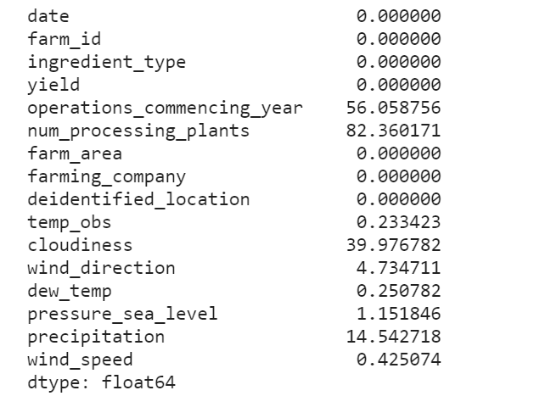
Data Wrangling
Is there any null values in the Data?
Yes,There are many null values in the data if null percentage is above 20% its hard to impute so dropping such columns to reduce overfitting
How to handle Null values?
Knn imputer
Iterative imputer
linear interpolation

Slide 25
Iterative Imputer:
Iterative Imputer is a machine learning technique used for imputing missing values in a dataset. It works by filling in the missing values with predicted values that are generated by iterating over the features of the dataset.
The iterative imputer algorithm uses a regression model to predict the missing values for each feature, and then repeats this process until the missing values converge to a stable solution. The algorithm is based on the idea that the missing values in a dataset are not completely random, but rather are correlated with other features in the dataset.

Slide 26
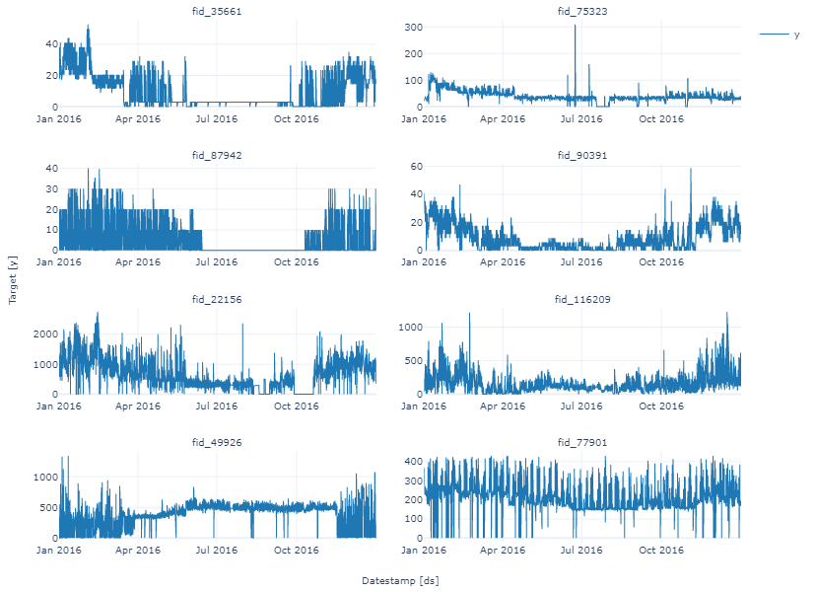
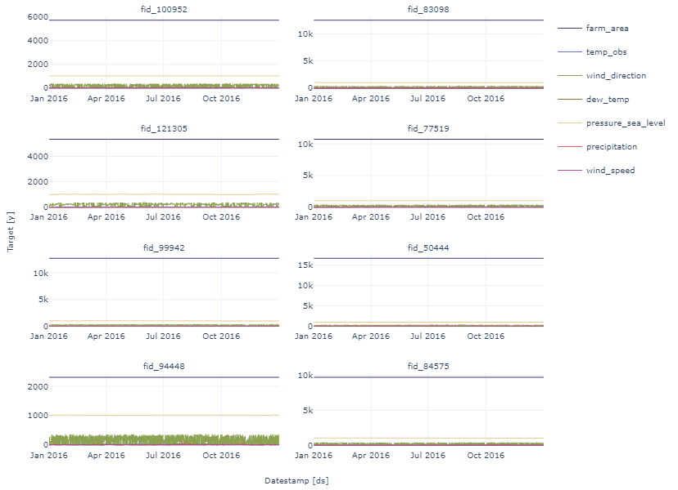
Plot Exogenous variables to time

Slide 27
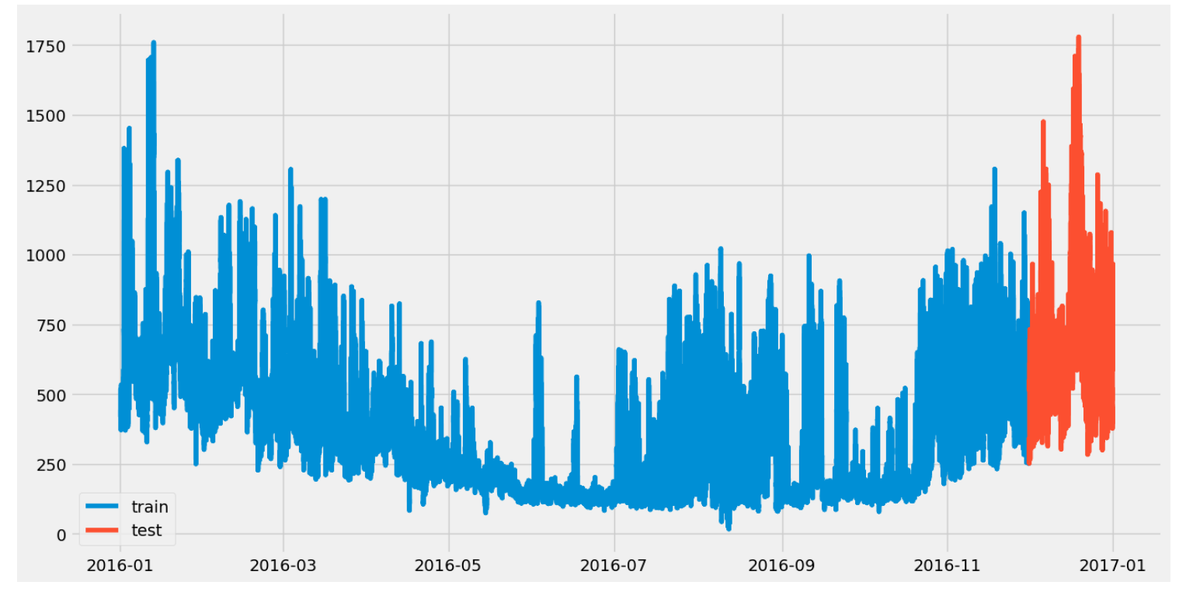
Train test split
Train data consists of 11 months data i.e (Jan-2016-November -2016)
Test data with 1 Month i.e (Dec 2016)

Slide 28

Model Building

Slide 29
Model –Approaches
Approach-1: Traditional Time series starting with AR,MA,ARMA,ARIMA
Approach-2: conversion of time series into lags and do lgbm and xgboost for every farm
Approch-3: Moved to Deep learning
Approach-4 : Hirerarchal Time series with bottom up approach
But,But, training time takes hours for single ingredient,because these libraries doesnot have faster compiling,so

Slide 30

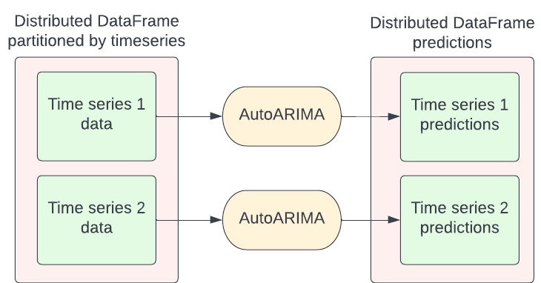
Nixtla –Statsforecast
Current Python alternatives for statistical models are slow, inaccurate and don’t scale well. So This library that can be used to forecast in production environments or as benchmarks. StatsForecast includes an extensive battery of models that can efficiently fit millions of time series.
Features:
Fastest and most accurate implementations of AutoARIMA, AutoETS, AutoCES, MSTL and Theta Python.
Out-of-the-box compatibility with Spark, Dask, and Ray.
Probabilistic Forecasting and Confidence Intervals.
Support for exogenous Variables and static covariates.

Slide 31
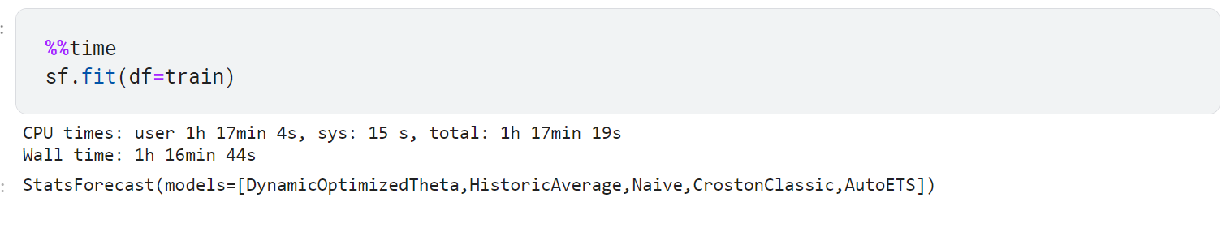
Training Time
For ingredient –z to fit multiple models in statsforecast library it took nearly 1.2 hours

Slide 32
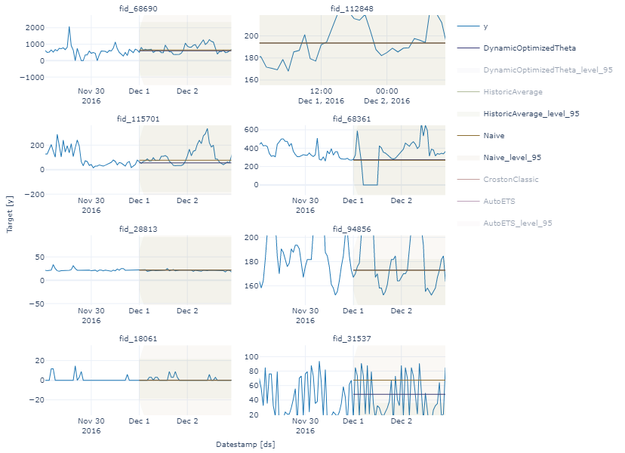

Slide 33
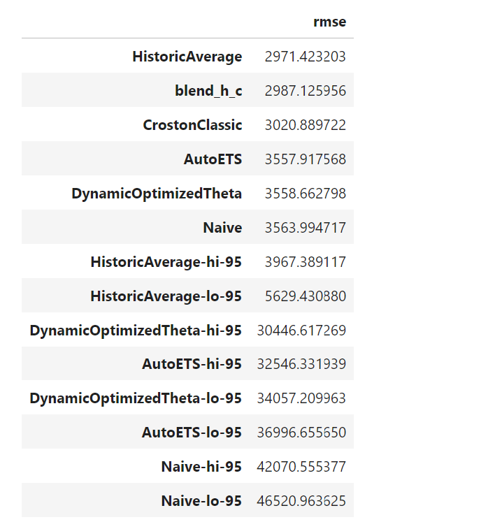
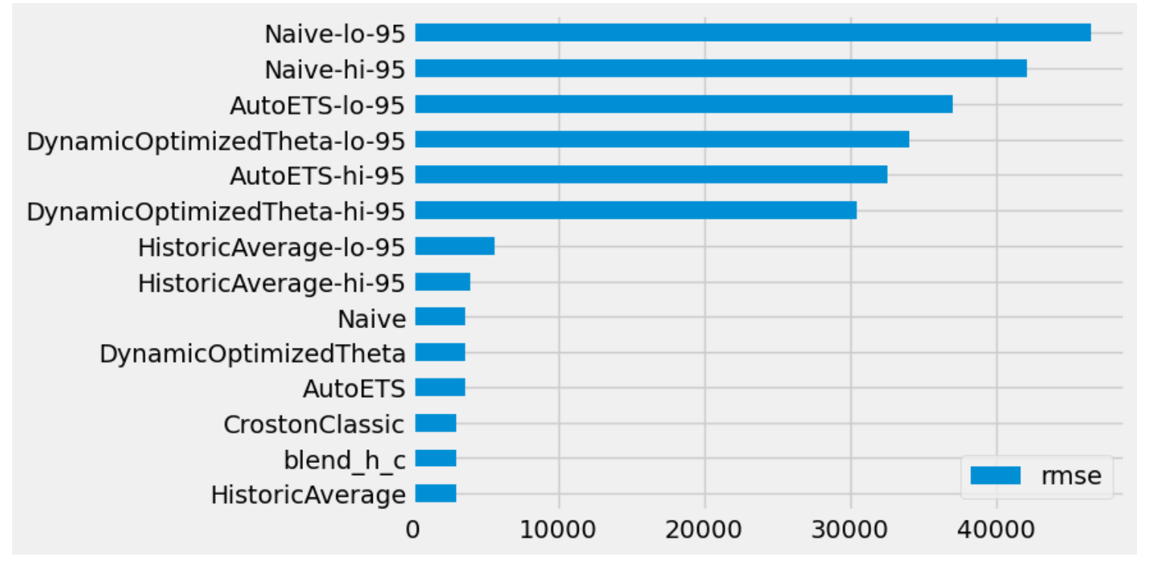
Model Results

Slide 34
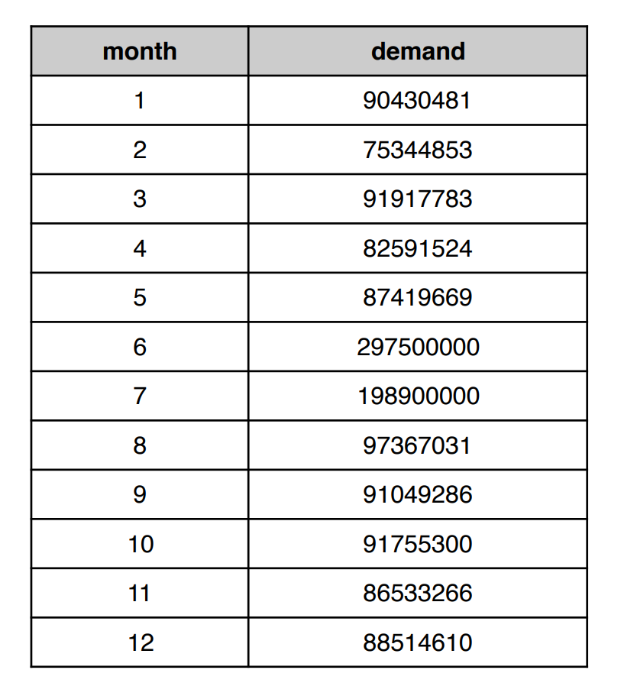
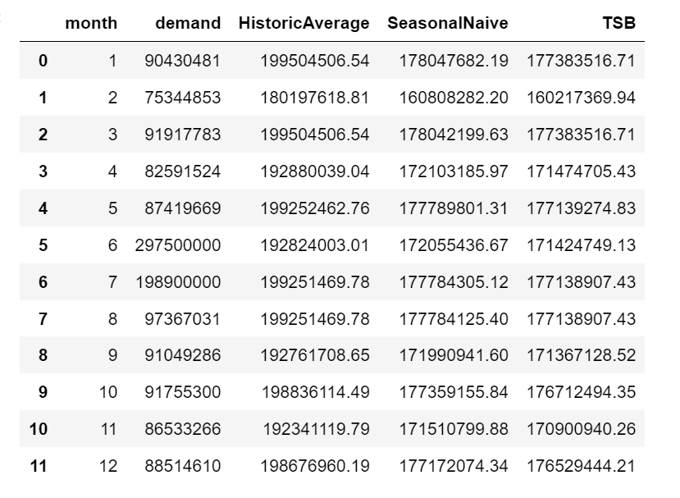
Evaluating results
Below is the forecasted demand for the next year (2017) for ‘ing_w’, using the model we need ensure where demand meets supply

Slide 35
Summary
From the model predictions ,The problem of shortage of ingredients were reduced
Focusing certain locations which produce more yield will also help to grow our bussiness
35

Slide 36




Thank you
Reesu Jagan
reesujagan42@gmail.com
codejay12.github.io

